Slide 1

A Comprehensive Analysis of Health Insurance Charges
Dharnesh Kumaran Thirunavakkarasu

Slide 2
Introduction
Business Problem:
Rising healthcare costs necessitate better understanding of insurance charges.
Identifying factors influencing charges can help in pricing strategies and customer segmentation.
Project Goals:
Predict insurance charges based on customer demographics and health factors.
Provide insights for insurance companies to optimize their offerings.
Implications of the Project:
Improved pricing models.
Enhanced customer satisfaction through tailored insurance plans.

Slide 3
the Dataset
Age: Continuous variable representing the age of the insured individual.
Sex: Categorical variable indicating the gender of the insured (male or female).
BMI (Body Mass Index): Continuous variable measuring body weight relative to height, indicating health status.
Children: Integer variable representing the number of dependents covered by the insurance plan.
Smoker: Categorical variable indicating whether the individual is a smoker (yes or no).
Region: Categorical variable describing the geographical area.
Input Variables:
Output Variable:
Charges: Continuous variable representing the medical insurance costs incurred by the insured individual. This is the target variable we aim to predict based on the input variables.

Slide 4
Descriptive Analysis
Statistical Overview
Descriptive Statistics:
The dataset contains 1,338 rows and 7 columns, with no missing values. Key statistics include:
Mean Charges: $13,270.42
Median Charges: $9,596.25
In the analysis, variance was calculated to assess the spread of the charges, indicating a high level of variability in insurance costs. Additionally, significant correlations between input variables and the target variable were evaluated to identify relationships that could impact predictions.

Slide 5
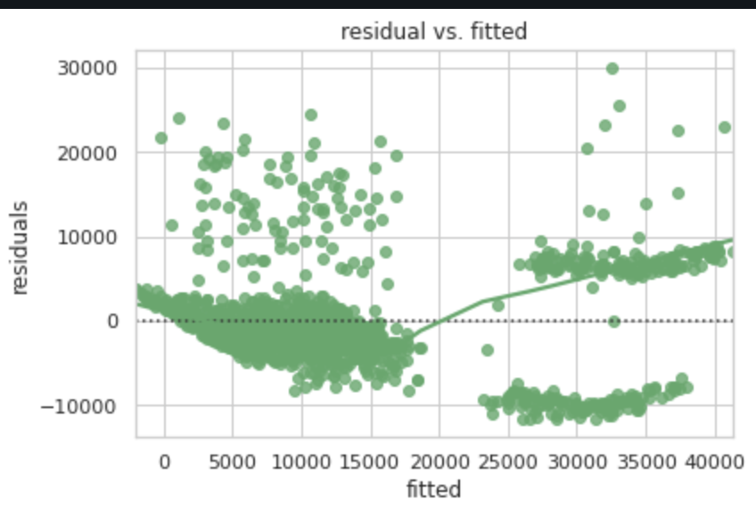
Data Visualization:
The visualization created a residuals vs. fitted plot to assess the model's performance by examining the distribution of residuals, which helps identify any patterns or potential outliers in the predictions.
This graphical representation aids in verifying the assumptions of linear regression and the quality of the model fit.

Slide 6
Algorithm
Models Used:
Linear Regression: A statistical method that models the relationship between a dependent variable and one or more independent variables by fitting a linear equation to observed data.
Decision Tree Regression: A non-linear predictive modeling technique that uses a tree-like graph of decisions to predict the value of a target variable based on input features.
Random Forest Regression: An ensemble learning method that constructs multiple decision trees during training and outputs the average prediction to improve accuracy and control overfitting.
Performance Indicators:​
R² Score​
Mean Absolute Error (MAE)​
Mean Squared Error (MSE)

Slide 7
Conclusion
Key Findings:
Significant Predictors Identified:
The analysis revealed several key predictors of insurance charges, including age, BMI, smoking status, and the number of children.
These variables demonstrated notable correlations with the target variable, indicating their importance in determining medical insurance costs.
Model Performance:
The regression models developed, particularly linear regression, showcased promising performance metrics.
The root mean squared error (RMSE) and R-squared values suggested that the models effectively captured the underlying patterns in the data, enabling accurate predictions of insurance charges.
This indicates the potential for these models to assist insurance companies in making data-driven decisions regarding premium pricing and risk assessment.

Slide 8
DataSet RESOURCES
This dataset was gathered from Kaggle: https://www.kaggle.com/datasets/mirichoi0218/insurance/code

Slide 9
Thank You

